Slide 1
INDUSTRIAL HUMAN RESOURCES GEO-VISUALIZATION
Predictive analysis &geo-visualization

Slide 2
Problem Statement:
In India, the industrial classification of the workforce is essential to understand the distribution of the labor force across various sectors
The classification of main workers and marginal workers, other than cultivators and agricultural laborers, by sex and by section, division, and class, has been traditionally used to understand the economic status and employment trends in the country. However, the current data on this classification is outdated and may not accurately reflect the current state of the workforce.
The aim of this study is to update the information on the industrial classification of the main and marginal workers, other than cultivators and agricultural laborers, by sex and by section, division, and class, to provide relevant and accurate data for policy making and employment planning.

Slide 3
Tools:
Python –programming language
Streamlit -web application
Pandas -data wrangling
Matplotlib and folium – data visualization

Slide 4
Project workflow:
Data loading –use pandas to load human resources data from dataset
Preprocessing-clean & preprocess the data include splitting columns
Data exploration – explore the data using streamlit user friendly interaction
Geo-visualization –use folium to create an interactive map

Slide 5
EDA insights:
Total no of state & district workers
Distribution of workers In rural , main and urban areas
Male &female ratios workers
Visualization of marginal workers in rural and urban areas

Slide 6
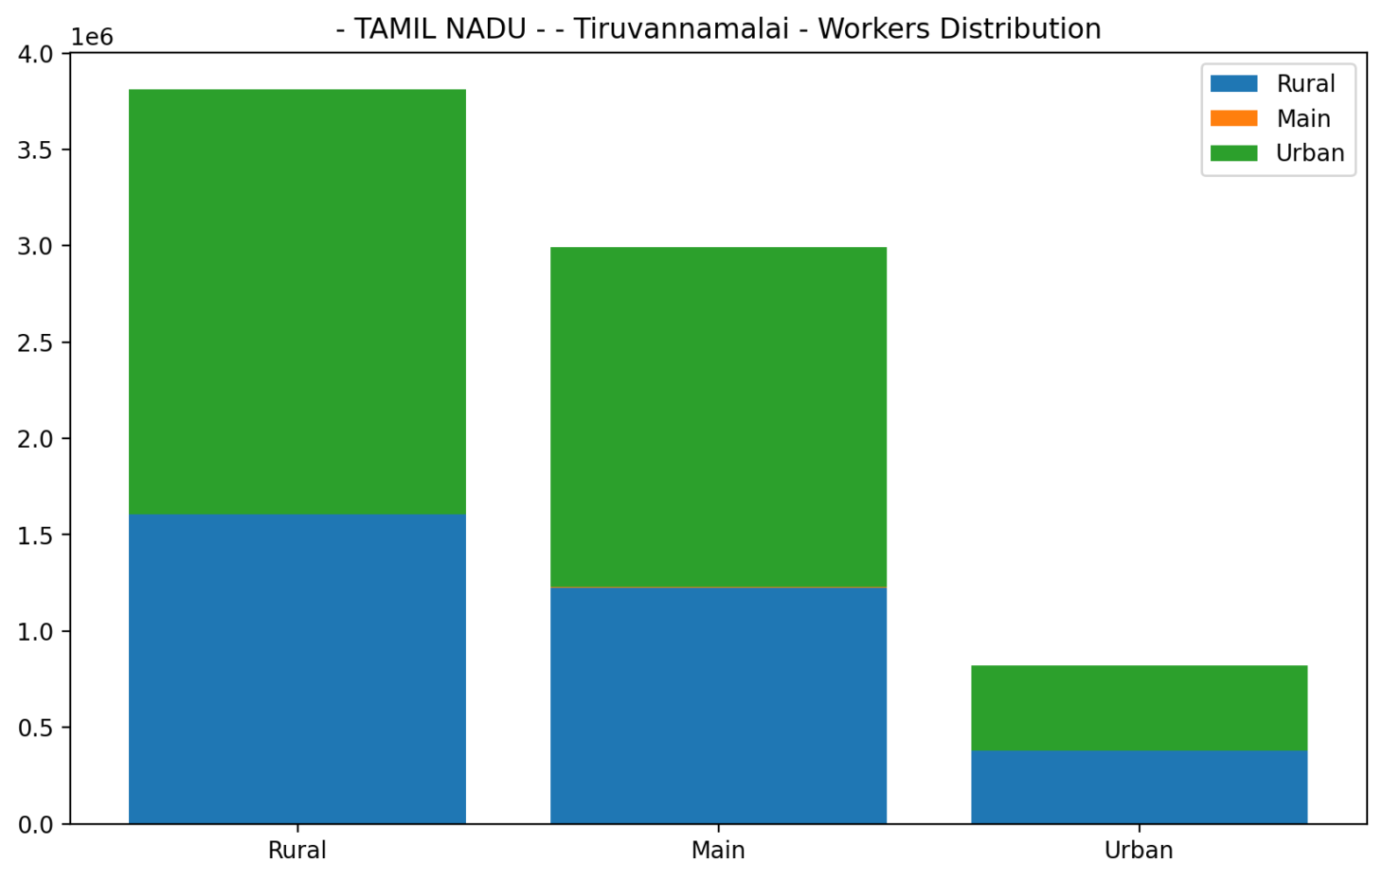

Slide 7
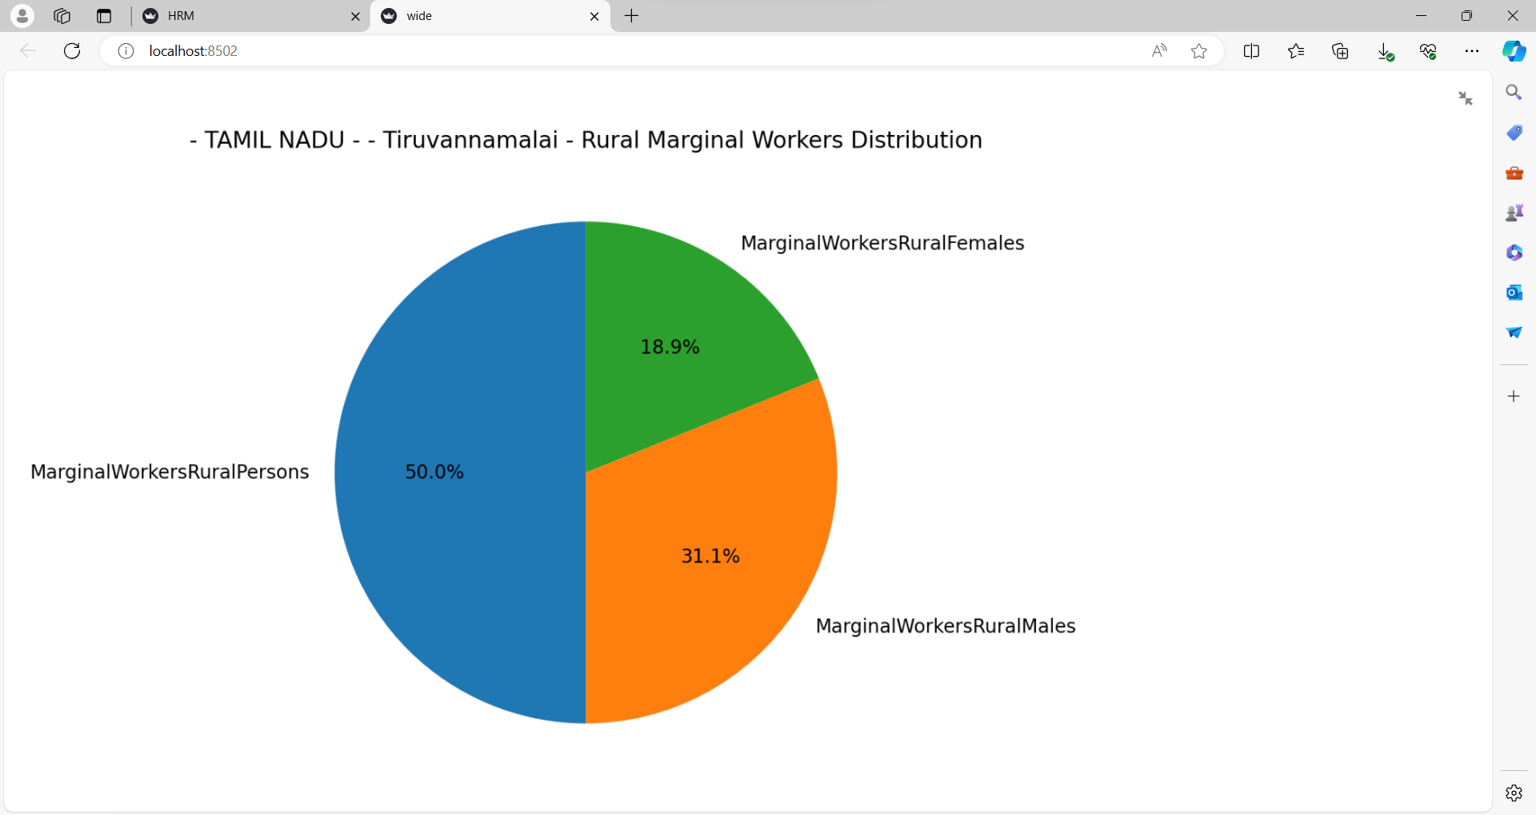

Slide 8
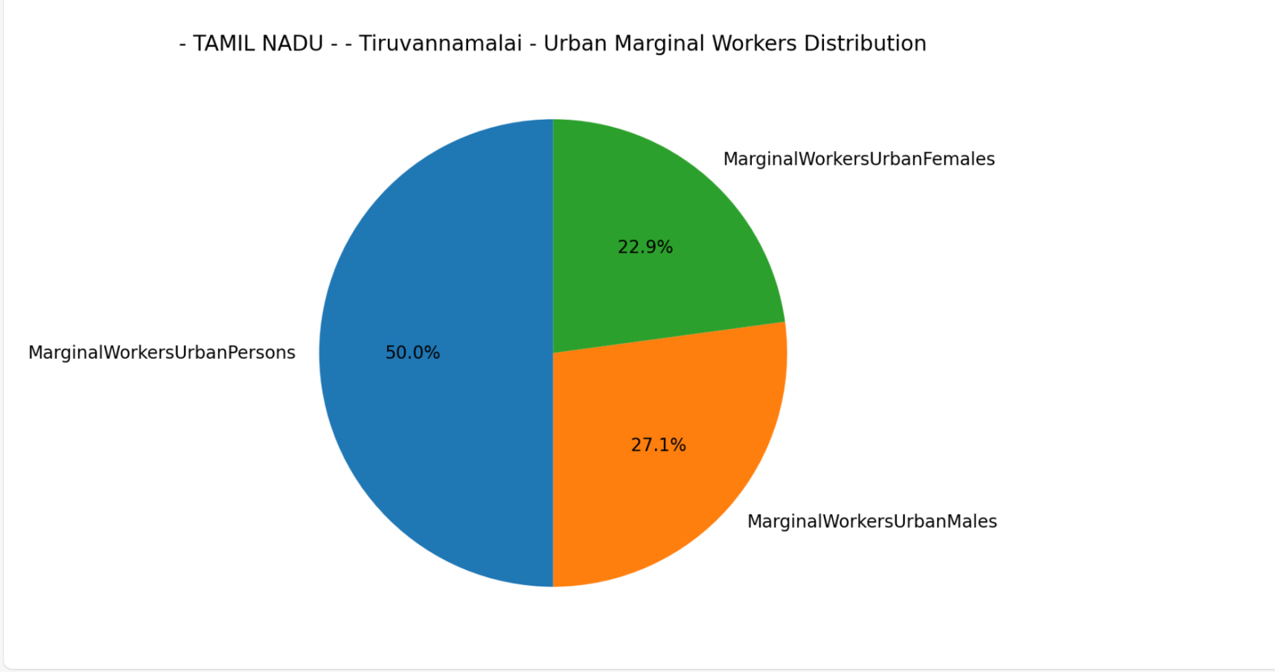

Slide 9
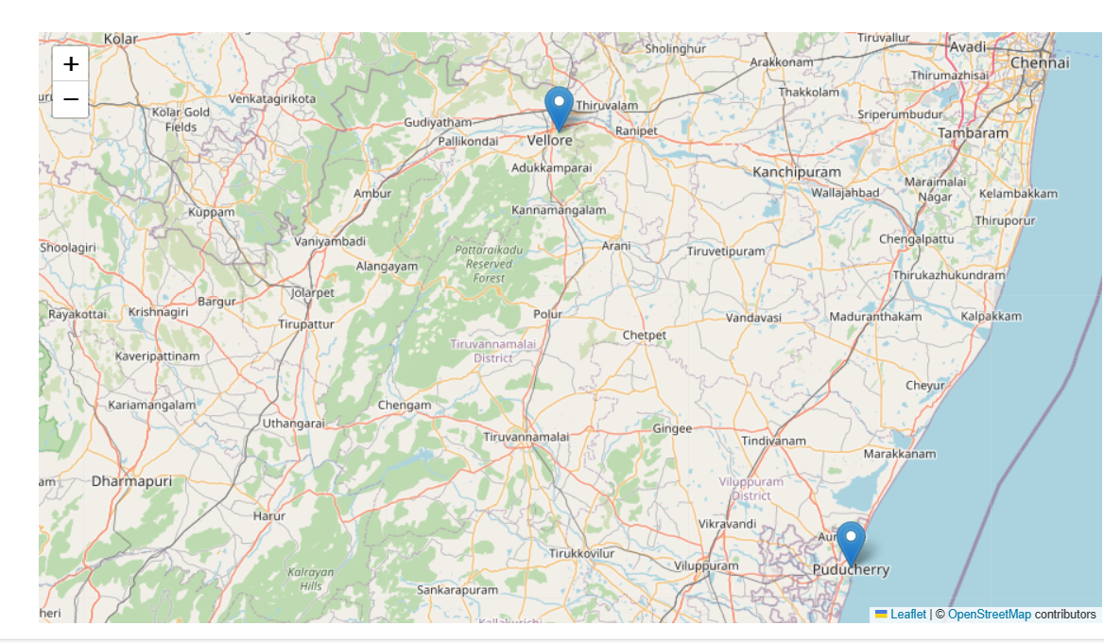

Slide 10
THANK YOU

